Slide 1
Block Types
Pure Blocks
Participants focus on only one of the two tasks
i.e., only doing the odd even task for all trials in a block
Switch Blocks
Participants change task type for different trials in the same block.

Slide 2
Block Types
Alternating Runs Switch Task
Task instructions change after every other trial
i.e., CV, CV, OE, OE, CV, CV

Slide 3
Block Types
Alternating Runs Switch Task
Task instructions change after every other trial
i.e., CV, CV, OE, OE, CV, CV
Every other trial is a switch trial

Slide 4
Switch Costs
Local switch costs – Comparison of trials within a switch block
Global switch costs – Comparison of non-switch trials (within a switch block) to pure trials (i.e., non-switch blocks)

Slide 5
Switch Costs
Local switch costs reflect task-set reconfiguration that arises from changing tasks across trials
Global switch costs represent the cost of actively maintaining two different tasks sets relative to only having to perform a single task.

Slide 6
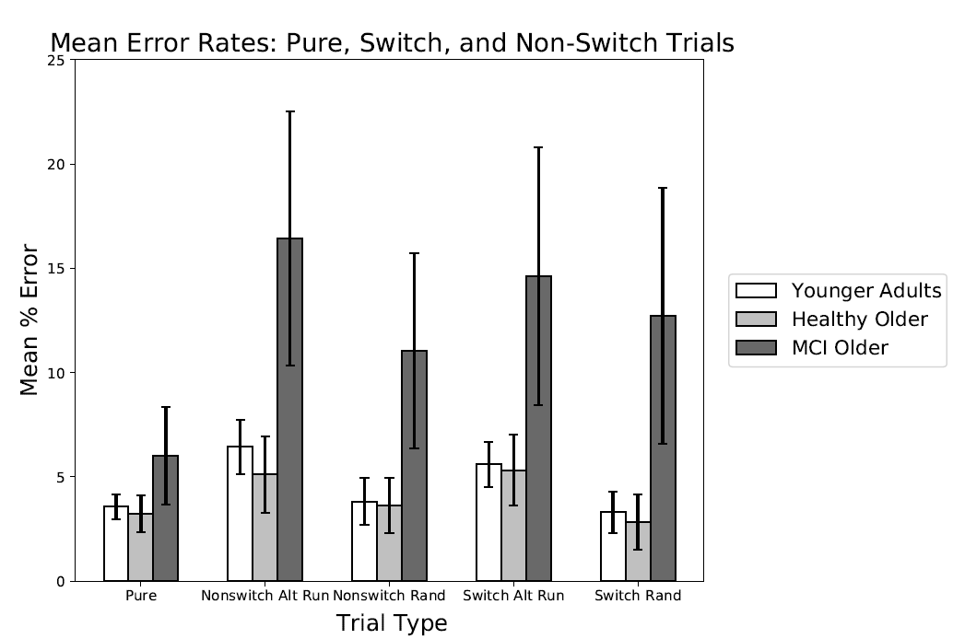

Slide 7
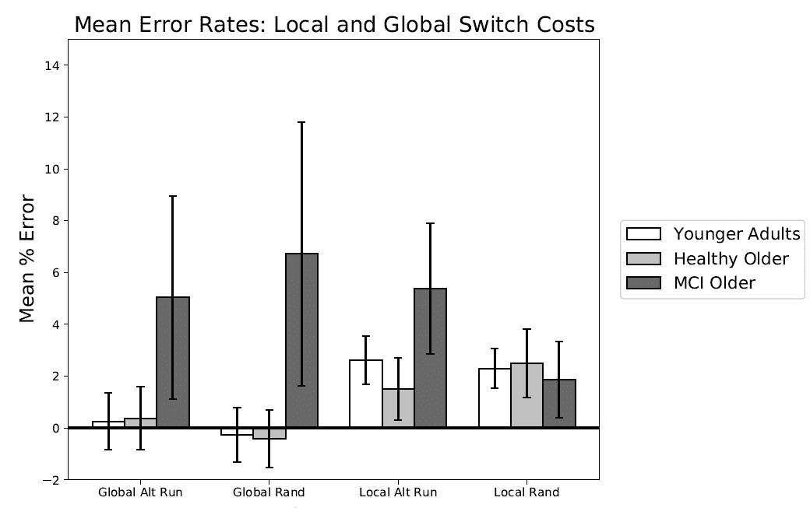

Slide 8
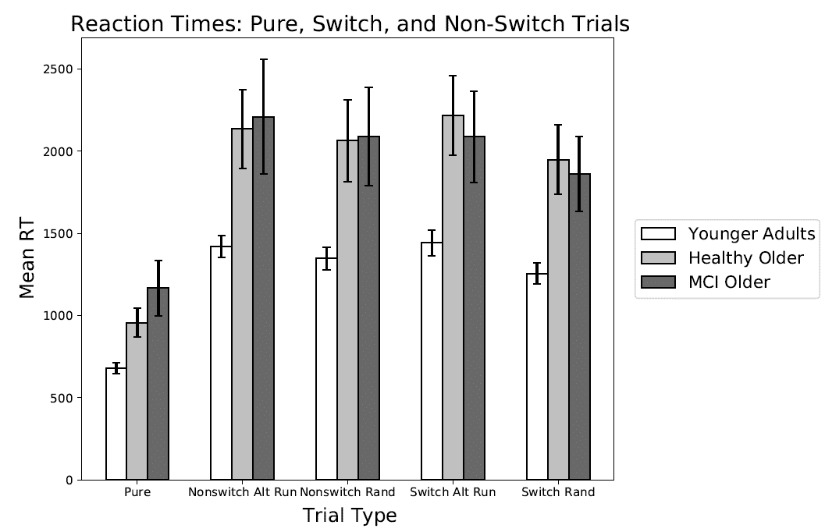

Slide 9
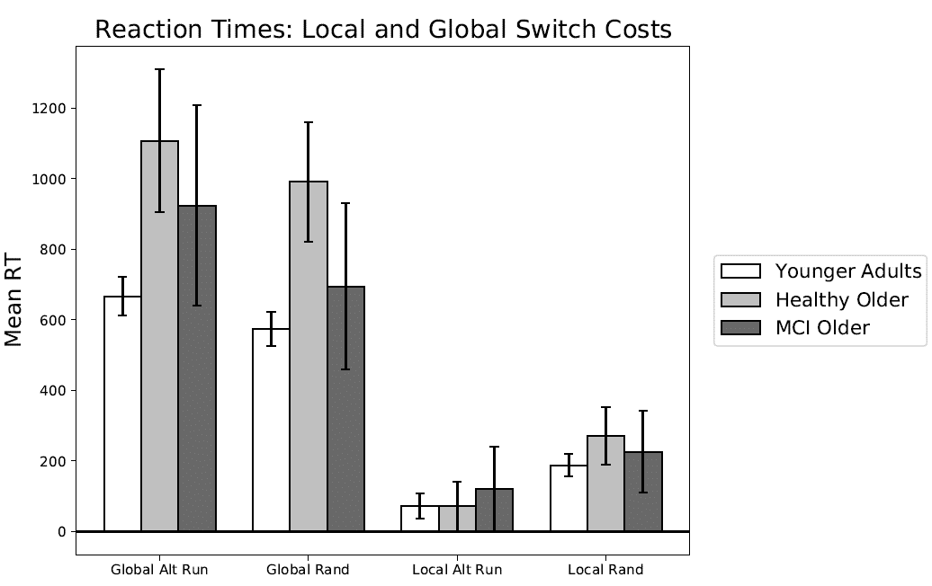

Slide 10
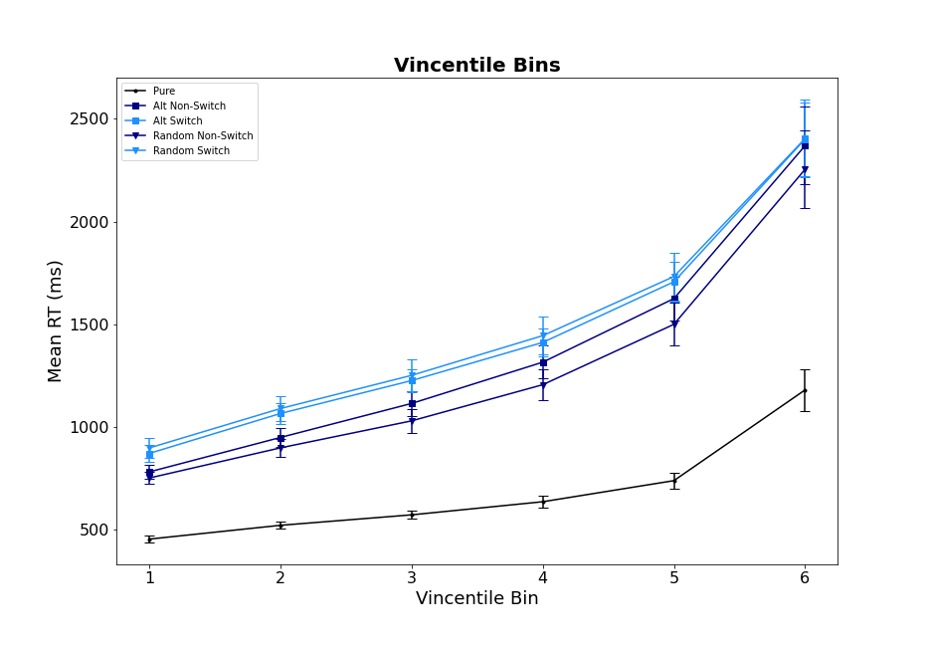
Younger Adult Vincentiles

Slide 11
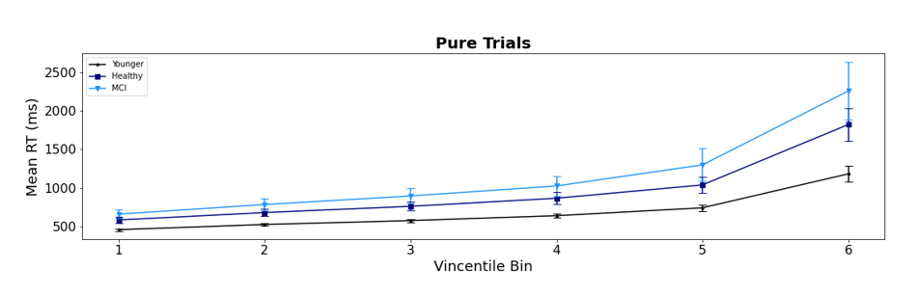
All Groups Vincentiles -- Pure

Slide 12
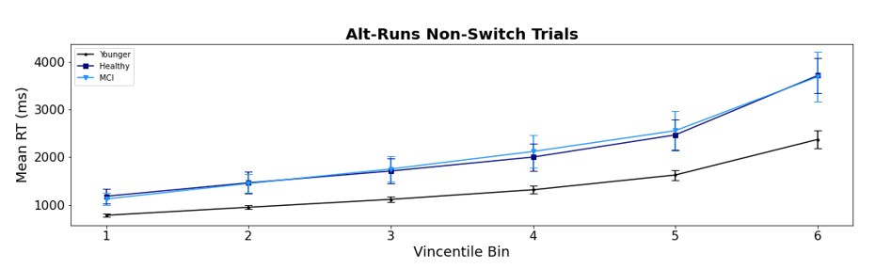
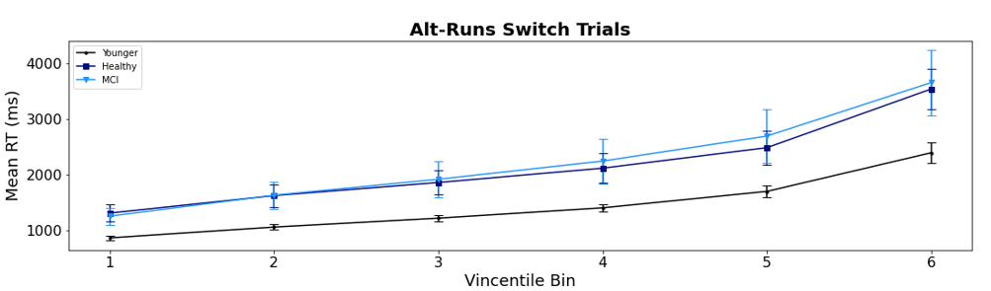
All Groups Vincentiles – Alt Runs

Slide 13
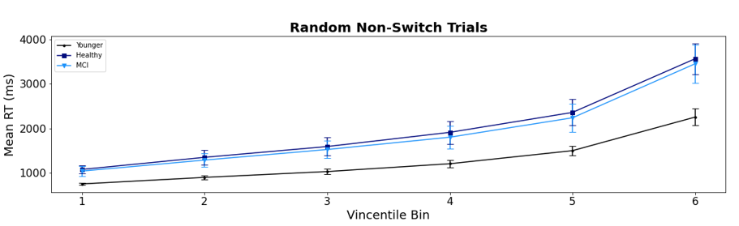
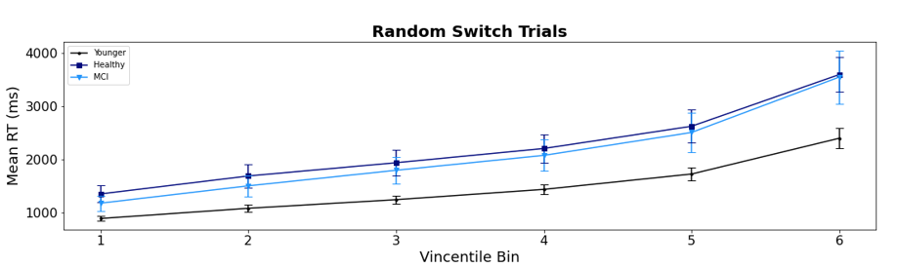
All Groups Vincentiles – Random

Slide 14
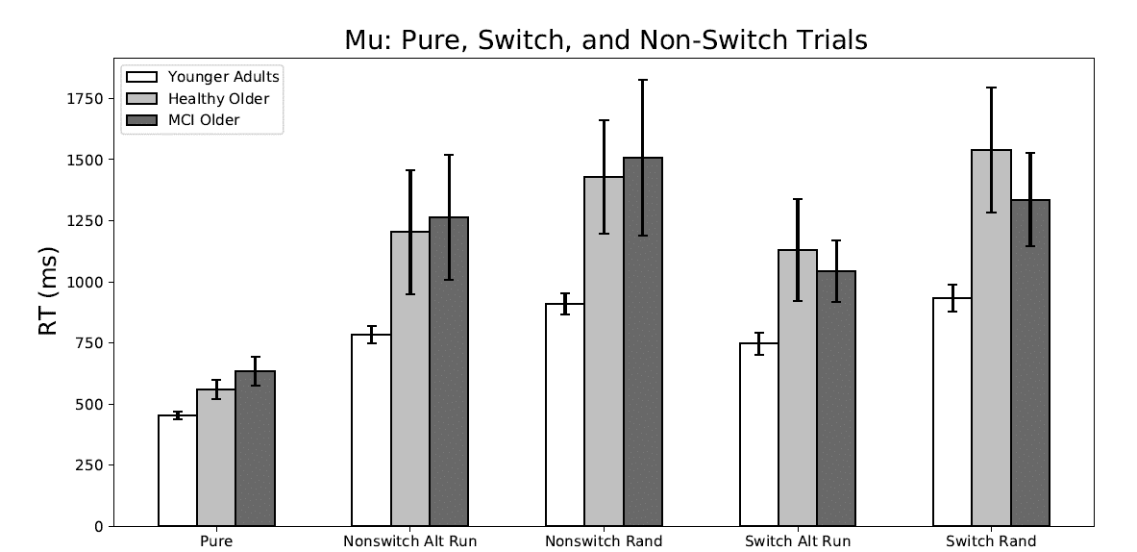

Slide 15
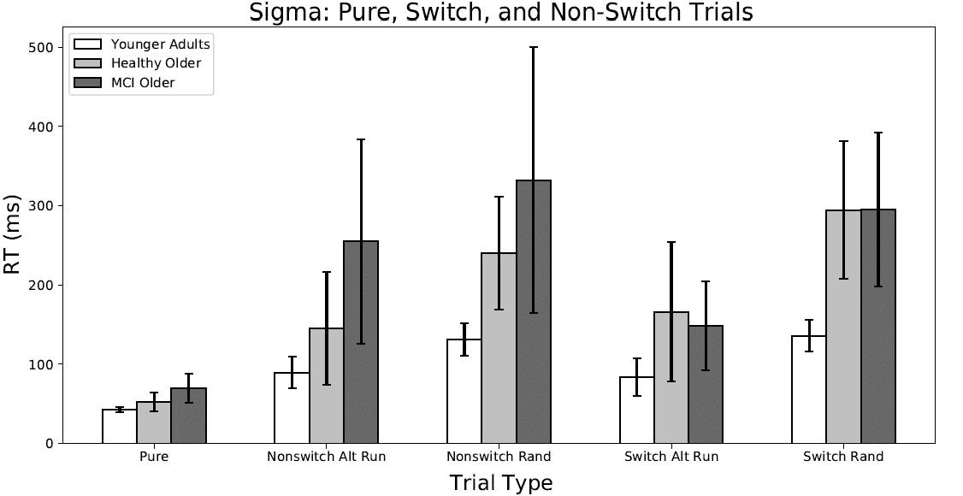

Slide 16
